Slide 1

DEPARTMENT OF ARTIFICIAL INTELLIGENCE AND DATA SCIENCE
Artificial Neural Networks and Deep Learning: 21ADG64
LA1 - Seminar
“CNN ARCHITECTURE”
Presented By
R DEEKSHA
1NT21AD038
Name of the Course Instructor Dr Meenakshi

Slide 2

CONTENTS
Introduction and Motivation
Methodology and Approach
Results and Analysis
Conclusion and Future Recommendations
Demo video of code
Github link of PPT and Code
References

Slide 3
INTRODUCTION
Convolutional neural networks, or CNNs or ConvNets, are a subclass of neural networks that are particularly good at processing data with a topology resembling a grid, like images. A binary representation of visual data is what makes up a digital image. It is made up of a grid-like arrangement of pixels with pixel values to indicate the colour and brightness of each pixel.
Convolutional neural networks (CNNs) are neural networks that have one or more convolutional layers and are mainly used for image processing, classification, segmentation, and other auto-correlated data.

Slide 4
MOTIVATION
1. Convolution leverages three important ideas to
improve ML systems:
1. Sparse interactions
2. Parameter sharing
3. Equivariant representations
2. Convolution also allows for working with inputs of
variable size

Slide 5
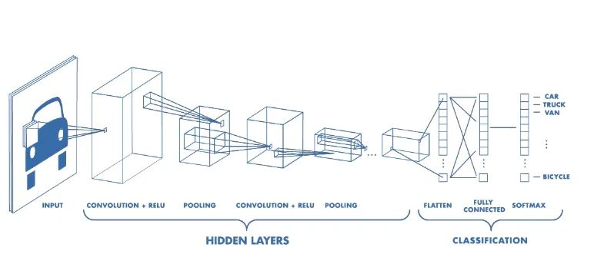
METHODOLOGY AND APPROACH
Convolutional Neural Network Architecture
A CNN typically has three layers:
a convolutional layer,
a pooling layer,
a fully connected layer.

Slide 6
METHODOLOGY AND APPROACH
Layer of Convolution
The fundamental component of the CNN is the convolution layer. It bears the majority of the computational load on the network.
This layer does a dot product between two matrices: the restricted area of the receptive field is one matrix, and the other matrix is the set of learnable parameters, also referred to as a kernel. Compared to an image, the kernel is more in-depth but smaller in space. This indicates that the depth fills up all three channels while the kernel height and width are spatially tiny if the image consists of three (RGB) channels.

Slide 7
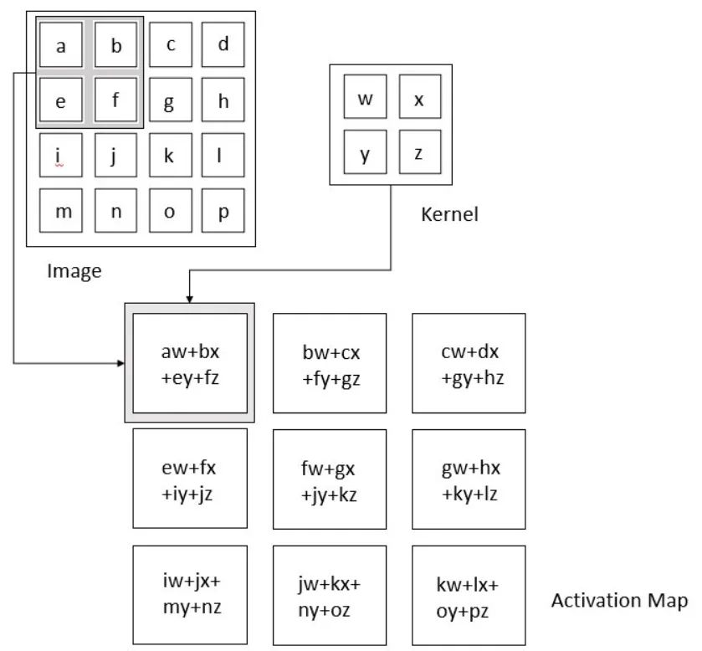
METHODOLOGY AND APPROACH

Slide 8
METHODOLOGY AND APPROACH
As seen the kernel creates the image representation of that receptive region by sliding across the image's height and width during the forward pass. This results in the creation of an activation map, a two-dimensional representation of the image that shows the kernel's response at each spatial location in the image. A stride is the name given to the kernel's sliding size.

Slide 9
METHODOLOGY AND APPROACH
Layer of Pooling By calculating a summary statistic from the outputs in the vicinity, the pooling layer substitutes the network's output at specific points. This aids in shrinking the representation's spatial size, which lowers the quantity of computation and weights needed. Each slice of the representation is processed independently for the pooling operation. There are several pooling functions such as the average of the rectangular neighborhood, L2 norm of the rectangular neighborhood, and a weighted average based on the distance from the central pixel. However, the most popular process is max pooling, which reports the maximum output from the neighborhood.

Slide 10
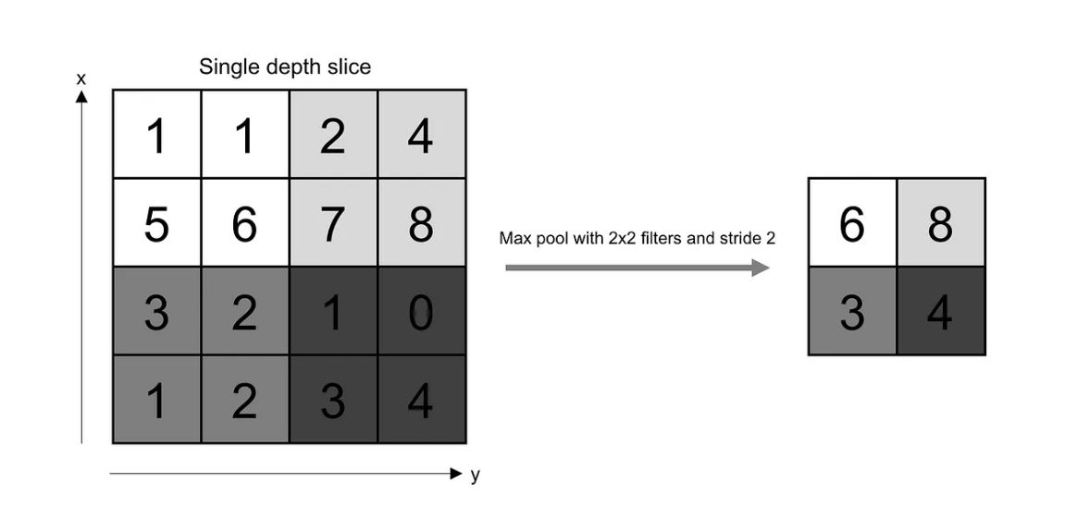
METHODOLOGY AND APPROACH
How pooling layer works..
Types of Pooling Layers:
MAX pooling
AVG pooling

Slide 11
METHODOLOGY AND APPROACH
Fully connected layer
As in a regular FCNN, all neurons in this layer are fully connected to all neurons in the layer that comes before and after. Because of this, it can be calculated using the standard method of matrix multiplication and bias effect. The representation between the input and the output is mapped with the aid of the FC layer.

Slide 12
METHODOLOGY AND APPROACH
Designing a Convolutional Neural Network:
Our convolutional neural network has architecture as follows:
[INPUT]
→[CONV 1] → [BATCH NORM] → [ReLU] → [POOL 1]
→ [CONV 2] → [BATCH NORM] → [ReLU] → [POOL 2]
→ [FC LAYER] → [RESULT]
We can use any activation function like sigmoid,tanh instead of ReLu. We can also add as many Convulational layer as required.

Slide 13
RESULT AND ANALYSIS
We feed the first convolutional layer an input image. Activation maps are obtained from the convoluted output. In order to move forward, the filters used in the convolution layer extract pertinent features from the input image.
Different features will be provided by each filter to help with accurate class prediction. Valid padding is used since it helps to reduce the number of features; in the event that we need to maintain the size of the image, we use the same padding (zero padding).
The number of parameters is then further decreased by adding pooling layers.
A number of pooling and convolutional layers are added prior to prediction.

Slide 14
RESULT AND ANALYSIS
Convolutional layer help in extracting features. As we go deeper in the network more specific features are extracted as compared to a shallow network where the features extracted are more generic.
The output layer in a CNN as mentioned previously is a fully connected layer, where the input from the other layers is flattened and sent so as the transform the output into the number of classes as desired by the network.
The output is then generated through the output layer and is compared to the output layer for error generation. A loss function is defined in the fully connected output layer to compute the mean square loss.

Slide 15
CONCLUSION AND FUTURE RECOMMENDATION
Thus ,CNNs (Convolutional Neural Networks) are deep learning algorithms commonly used for tasks like image classification, object detection, recommendation system and semantic segmentation. It may also involve accuracy metrics, while analysis includes evaluating misclassifications, examining object localization accuracy, and optimizing computational efficiency through architecture and training adjustment.

Slide 16
DEMO VIDEO OF CODE
The demo video consists of the code for CNN where we use CNN to do image classification.
The model is trained on the dataset with horses and humans with the known labels.
Then prediction can be done by uploading an image.
We can even see the layers of CNN through the code.

Slide 17
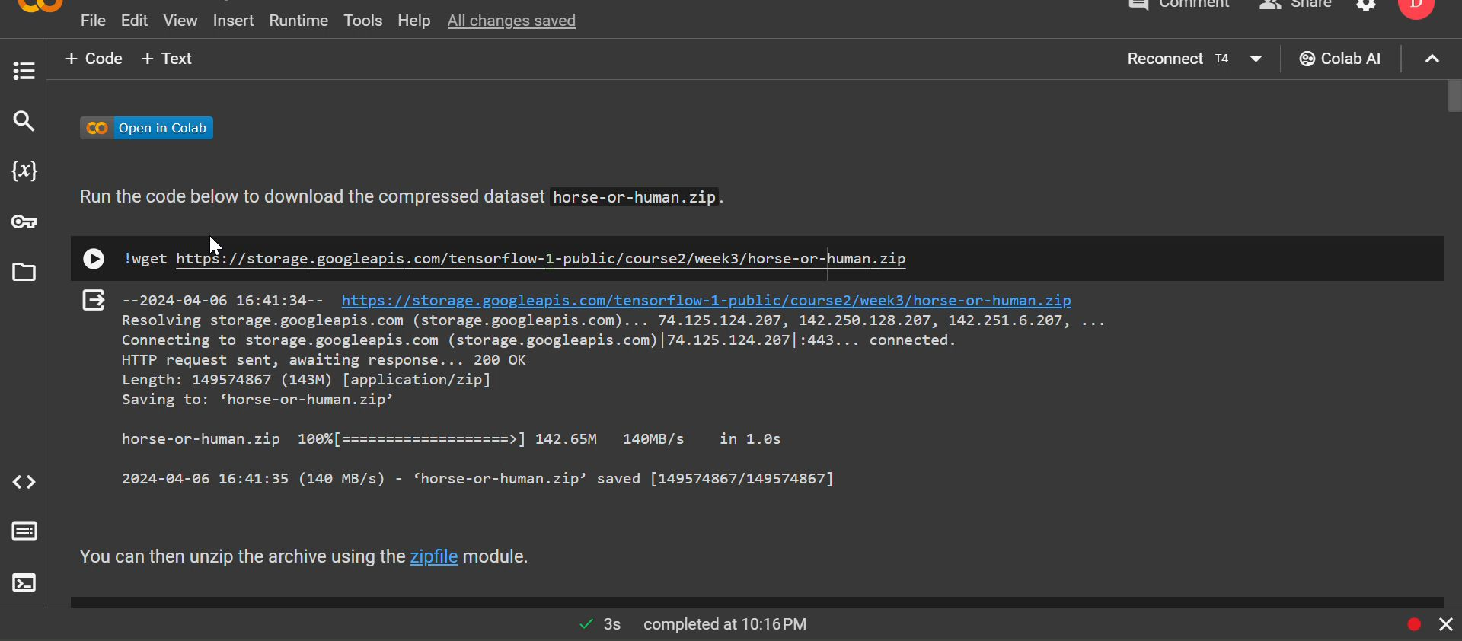
DEMO VIDEO OF CODE

Slide 18
GITHUB LINKS
This github link has the repository with the ppt and the code which works on image classification using CNN.
https://github.com/Deeksha-21/ANN-and-DL/tree/main

Slide 19
REFERENCES
https://searchenterpriseai.techtarget.com/definition/convolutional-neural-network
https://towardsdatascience.com/convolutional-neural-networks-explained-9cc5188c4939

